Slide 1
SAIKS 2022 final presentation
Bogdan Bordeianu, Filip Kovacevic, Nino Ziegelwanger
Notes:
1

Slide 2
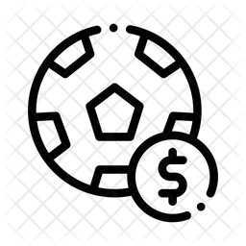


Application Domain
Football information system with betting capabilities Information about: Game results, transfers, clubs, teams, players, seasons, infrastructures, … But also: Bets on games, betting providers and their offered quotes User Accounts needed to place bets but: Football associates (players, club managers, referees) cannot place bets

Slide 3
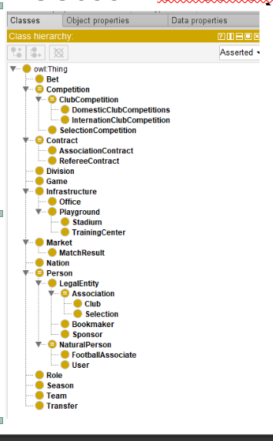
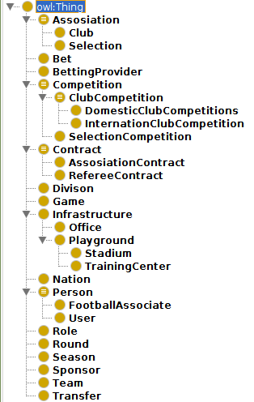
Football ontology members
Notes:
1

Slide 4
Ontology features - Advanced OWL2 features
disjointUnionOf | Club Competitions are a disjoint union of Domestic Club Competition and International Club Competitions.
propertyDisjointWith | :Transfer1 :newContract :Contract1 → :Transfer1 :oldContract :Contract1 cannot exist
Data types | hasQuote1, hasQuote2, hasQuoteX are of datatype xsd:double
Comments | “Is Nation an Enum?”
minQualifiedCardinality | International Club Competition has min 1 Division
qualifiedCardinality | Game has 2 Teams
Notes:
<number>

Slide 5
Ontology features - Ontology Design patterns
AssociationContract
hasAssociate
forSeason
hasRole
hasAssociation
FootballAssociate
hasName
hasNation
Role
hasName
Association
hasFoundingDate
hasInfrastructure
hasName
hasNation
hasTeam
Season
- hasName
- hasStartDate
- hasEndDate
Notes:
<number>

Slide 6
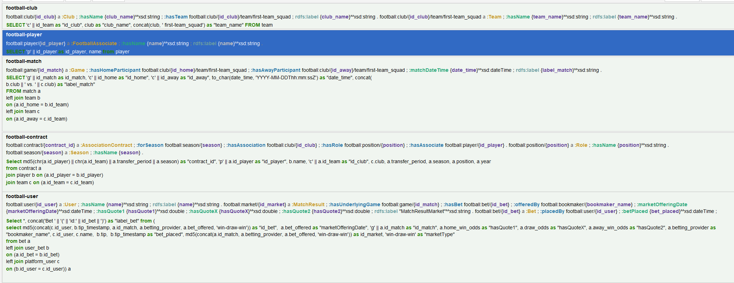
Ontop Mappings

Slide 7
SHACL(1)
Tip Constraint
If placed on a Match Result Market → String pattern “A|H|D”
If placed on another Market → String pattern “.*”
Quotes Constraint (for all quotes)
minExclusive 1
Password Constraint
Exactly 1
minLength 8

Slide 8
SHACL(2)
Nation Constraint
Exactly 1 Address
Must be a String or an Address Class
Association Contract Constraint
Exactly 1 Role
Min 1 Season
Exactly 1 Association
Exactly 1 FootballAssociate

Slide 9
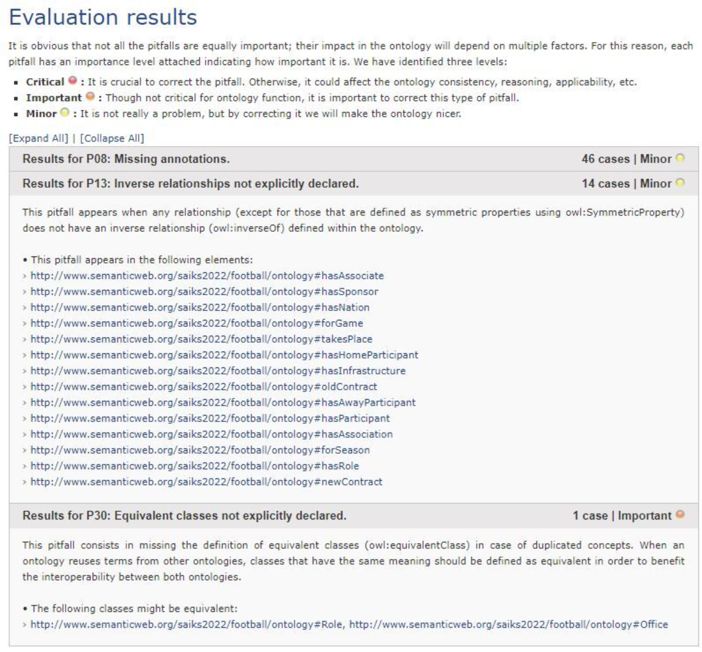
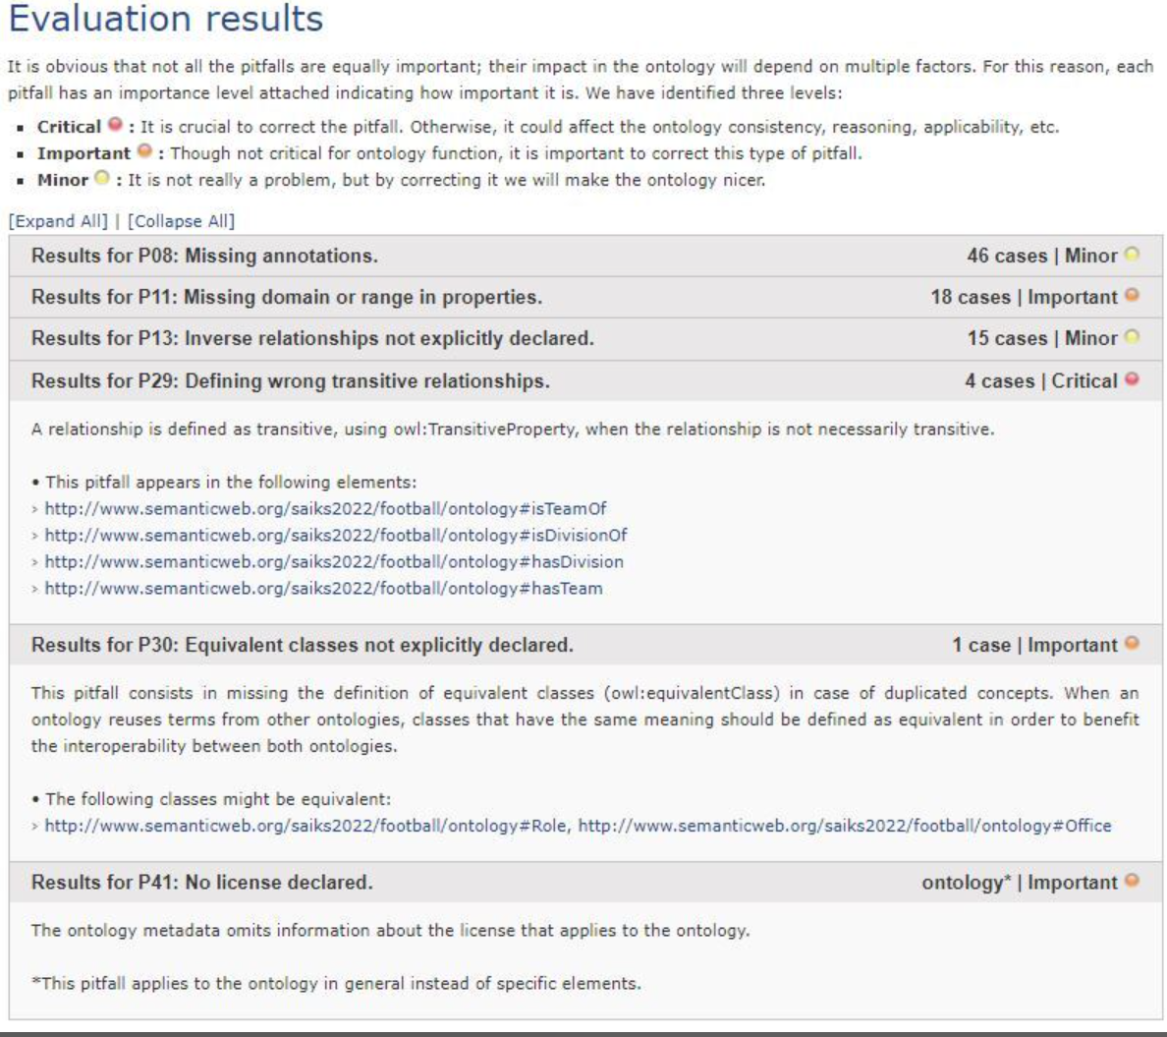
Oops! (Before and after)

Slide 10
Ontology Alignment – Our experience
* Two different ontologies found.
Different complexities
No betting concepts in the second ontology
* Used Logmap and AgreementMaker
Only Logmap was able to deliver a result for only one of the two ontologies
One similar class found
* Matched classes do not have the same semantics
Our Person class also includes legal bodies while the other does not

Slide 11
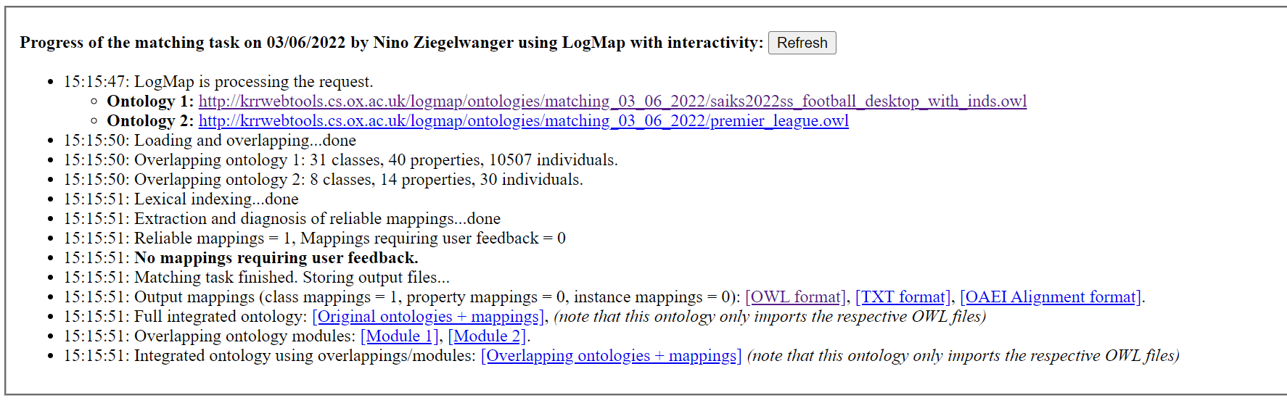
Ontology Alignment

Slide 12
Thank you!
Notes:
<number>

